Slide 1
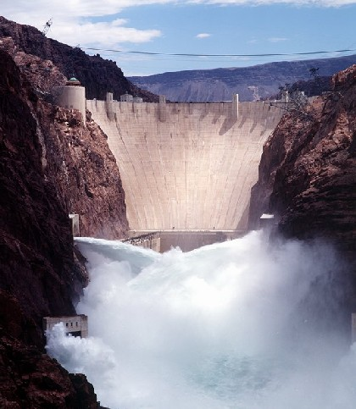
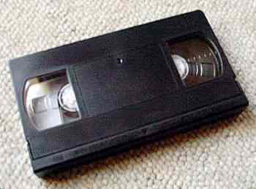
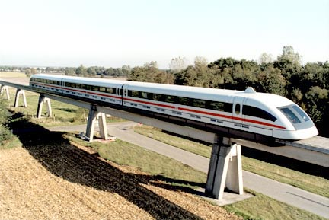
Chapter 34 The Faraday’s Law of Induction
(法拉第电磁感应 定律)
dA
B
B

Slide 2
General Review
Electrostatics (静电学)
    motion of “q” in external E-field
    E-field generated by Σq_{i}
Magnetostatics (稳恒磁场)
    motion of “q” and “i” in external B-field
    B-field generated by “i”
Electrodynamics (电动力学)
    time dependent B-field generates E-field
    AC circuits(交流电路), inductors(电感), transformers(变压器), etc.
    time dependent E-field generates B-field
      electromagnetic radiation (电磁辐射) - light!

Slide 3
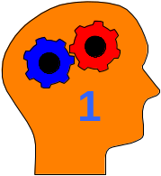
Today...
Induction Effects (电磁感应)
Faraday’s Law (Lenz’ Law，楞次定律)
  Energy Conservation with induced currents?
Faraday’s Law in terms of Electric Fields
Cool Applications

Slide 4
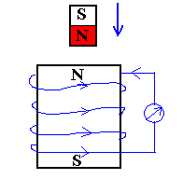
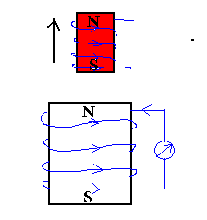
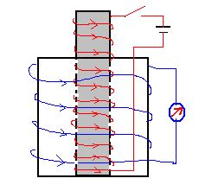
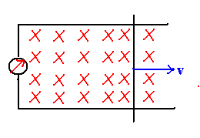
34-1 Basic Phenomena (基本现象)
Φ_{B} change→ε → Induced Current
Induced emf (电动势)

Slide 5
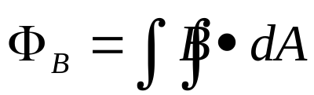

34-2 Faraday's Law of Induction
Define the flux of the magnetic field through an open surface as:
dA
B
B
Faraday's Law:
  The electromotive force (emf, 电动势) ε induced in a circuit is determined by the time rate of change of the magnetic flux through that circuit.
So what is
this emf??
  The minus sign indicates direction of induced current (given by Lenz's Law).

Slide 6
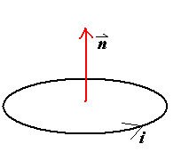
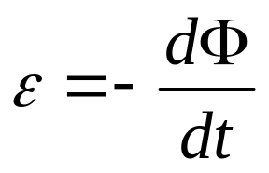
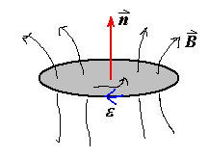
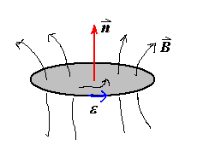
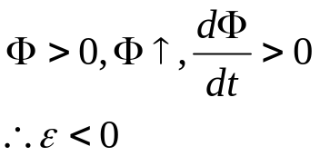
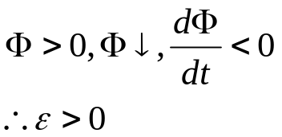
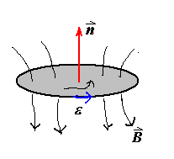
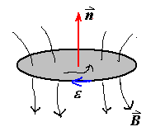
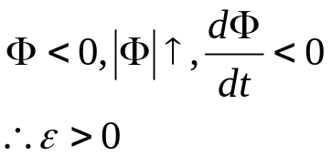
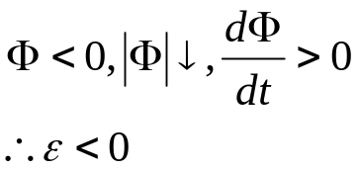
Sign of ε
Right Hand Rule

Slide 7
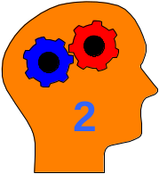
34-3 Lenz‘s Law (楞次定律)
Lenz's Law:
  The induced current will appear in such a direction that it opposes the change in flux that produced it.
B
B
S
N
N
S
v
v
Conservation of energy considerations:
  Claim: Direction of induced current must be so as to oppose the change; otherwise conservation of energy would be violated.
    Why???
      If current reinforced the change, then the change would get bigger and that would in turn induce a larger current which would increase the change, etc..

Slide 8

Application of Induction
E-M Cannon(电磁炮)
v
Connect solenoid to a source of alternating voltage.
~
The flux through the area ⊥ to axis of solenoid therefore changes in time.
side view
A conducting ring placed on top of the solenoid will have a current induced in it opposing this change.
B
F
•
•
B
There will then be a force on the ring since it contains a current which is circulating in the presence of a magnetic field.
•
F
B
top view

Slide 9
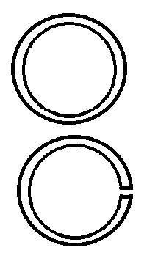
Chapter 34, Act 1
For this act, we will predict the results of variants of the electromagnetic cannon demo which you just observed.
  Suppose two aluminum rings are used in the demo; Ring 2 is identical to Ring 1 except that it has a small slit as shown. Let F₁ be the force on Ring 1; F₂ be the force on Ring 2.
3A
(a) F₂ < F₁
(b) F₂ = F₁
(c) F₂ > F₁
3B
Suppose two identically shaped rings are used in the demo. Ring 1 is made of copper (resistivity = 1.7X10⁻⁸ Ω-m); Ring 2 is made of aluminum (resistivity = 2.8X10⁻⁸ Ω-m). Let F₁ be the force on Ring 1; F₂ be the force on Ring 2.
(a) F₂ < F₁
(b) F₂ = F₁
(c) F₂ > F₁

Slide 10
Chapter 34, Act 1
For this act, we will predict the results of variants of the electromagnetic cannon demo which you just observed.
  Suppose two aluminum rings are used in the demo; Ring 2 is identical to Ring 1 except that it has a small slit as shown. Let F₁ be the force on Ring 1; F₂ be the force on Ring 2.
3A
(a) F₂ < F₁
(b) F₂ = F₁
(c) F₂ > F₁
The key here is to realize exactly how the force on the ring is produced.
A force is exerted on the ring because a current is flowing in the ring and the ring is located in a magnetic field with a component perpendicular to the current.
An emf is induced in Ring 2 equal to that of Ring 1, but NO CURRENT is induced in Ring 2 because of the slit!
Therefore, there is NO force on Ring 2!

Slide 11
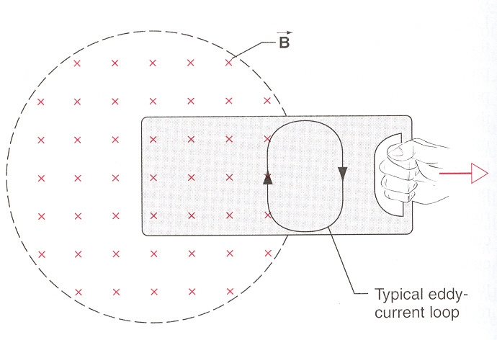
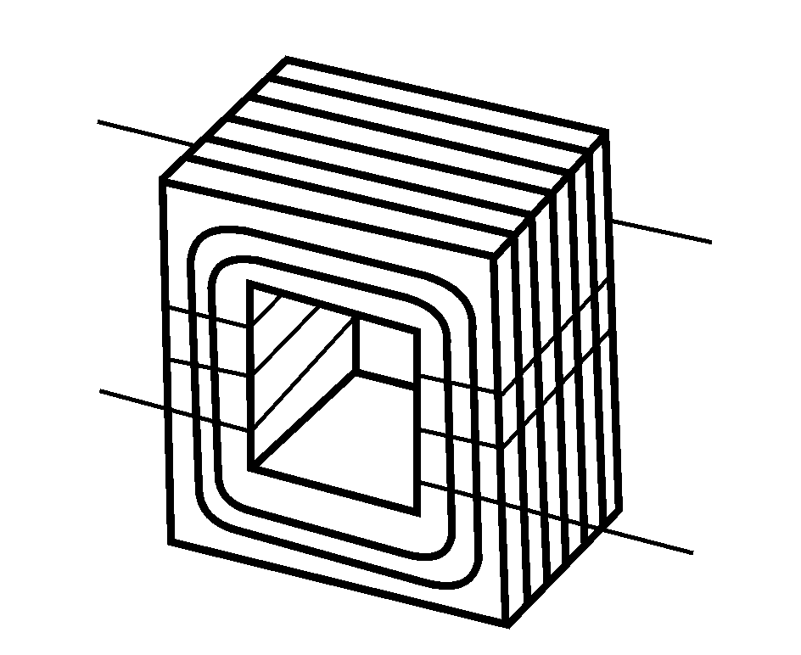
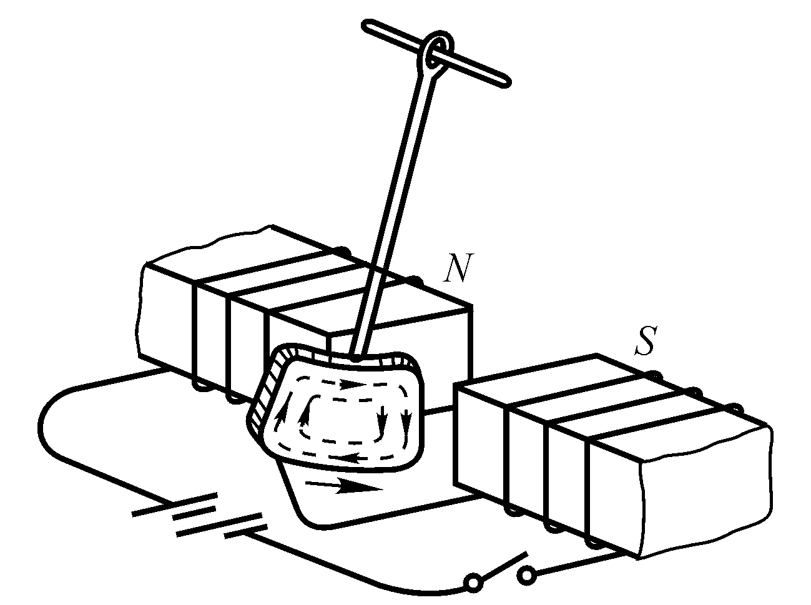
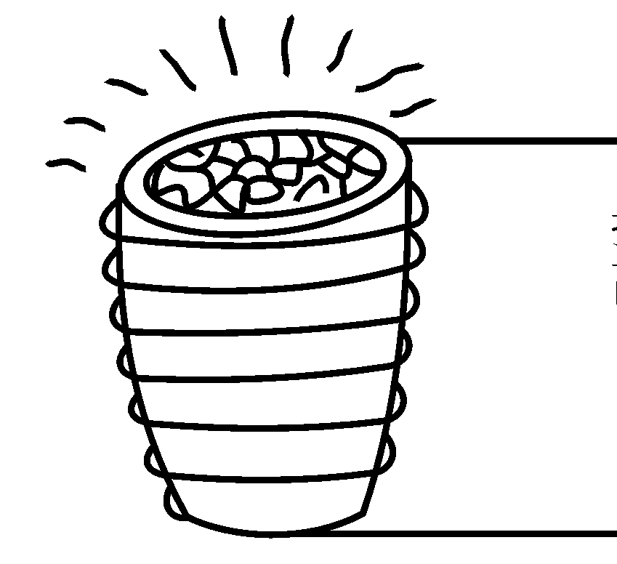
Eddy currents(涡流)
Materials are laminated.
Induction furnace
Magnetic breaking

Slide 12
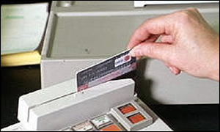
More Applications of Magnetic Induction
Tape / Hard Drive / ZIP Readout
  Tiny coil responds to change in flux as the magnetic domains (encoding 0’s or 1’s) go by.
  Question: How can your VCR display an image while paused?
Credit Card Reader
  Must swipe card
  → generates changing flux
  Faster swipe → bigger signal

Slide 13
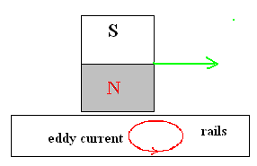
More Applications of Magnetic Induction
Magnetic Levitation (Maglev) Trains
  Induced surface (“eddy”) currents produce field in opposite direction
  → Repels magnet
  → Levitates train
  Maglev trains today can travel up to 620 km/hr
  → Almost Twice the speed of 高铁’s fastest conventional train!
  May eventually use superconducting loops to produce B-field
    → No power dissipation in resistance of wires!

Slide 14
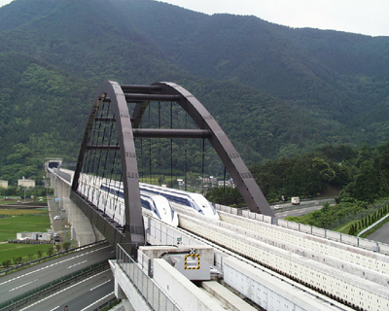
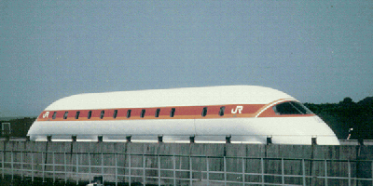
Superconducting MagLev in Japan
610km/hr

Slide 15
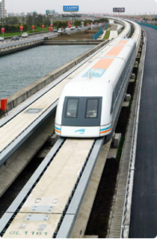

Magnetic Levitation (Maglev)
Trains in Shanghai, 411km/hrs

Slide 16
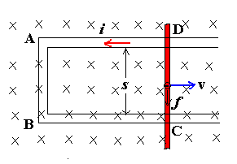
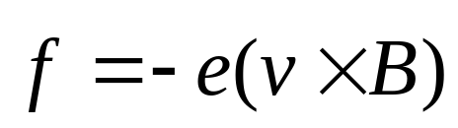
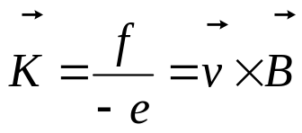
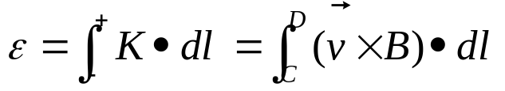
34-4 Motional emf (动生电动势) and
Induced emf (感生电动势)
In a steady magnetic field, moving conductor: motional emf
Conductor in steady, Changing magnetic field: induced emf
Motional emf (动生电动势):
Lorentz force results in a motional emf.
Electron moves in the direction of DCBA
Non electrostatic force:
（非静电力）
Motional emf:

Slide 17
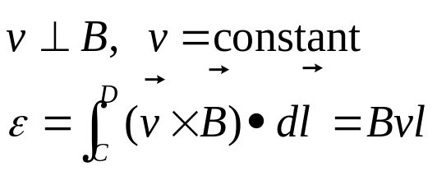
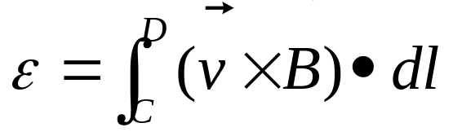

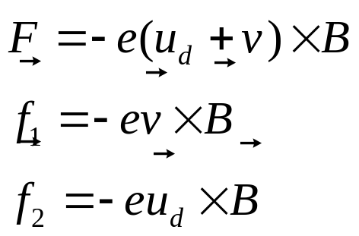
Notes
In high school case:
Motional emf exists only in the moving conductor
For any cases, (any shape, closed, non-closed)
Lorentz force can’t do work to electron! Why we speak that Lorentz force results in a motional emf？ Due to: the velocity of electron
Do positive work
Do negative work

Slide 18
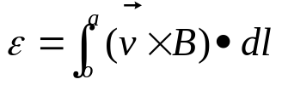
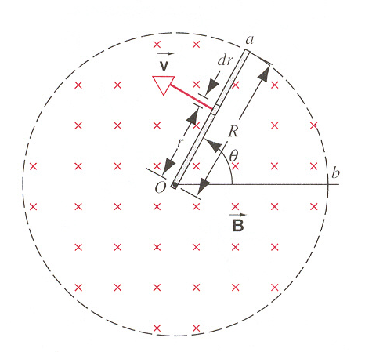
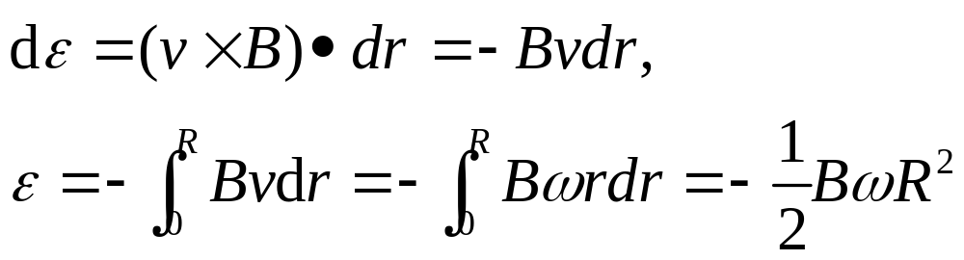
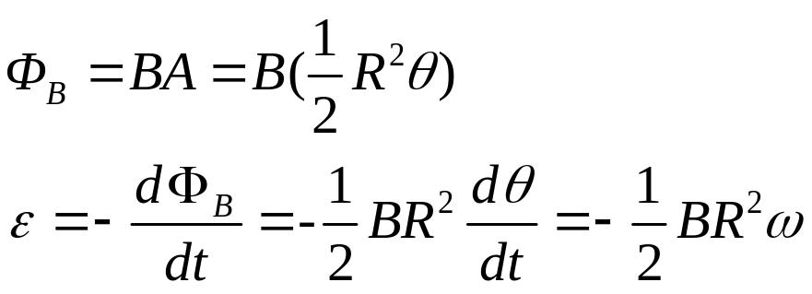
Example: Page 781, Sample problem 34-4
Solution 1:
Solution 2: Suppose oab is a loop,
A copper rod of length R, angular frequency ω, in an uniform magnetic field B
What is the direction of induced emf?
+ o, - a

Slide 19
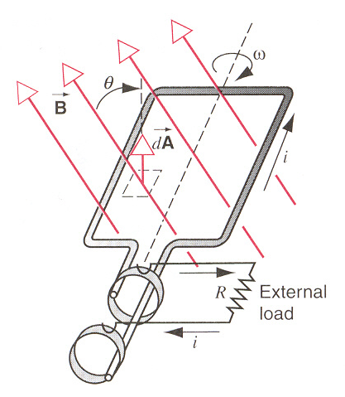
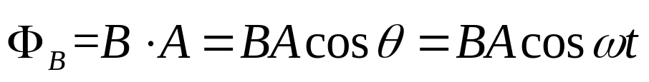
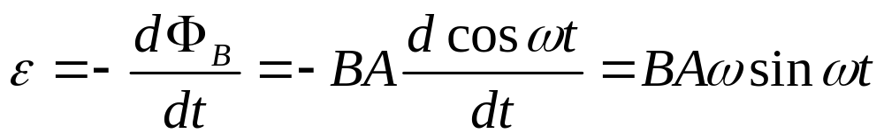
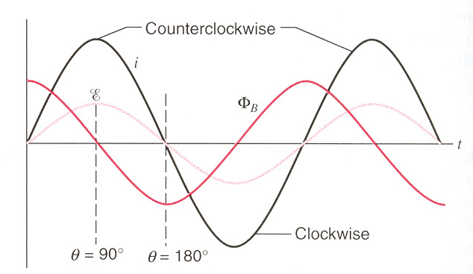
Applications: Generators and Motors (发电机和电动机)
Generator is a device for converting mechanical work (or other) into electrical work in the load.
Alternating current (AC)

Slide 20
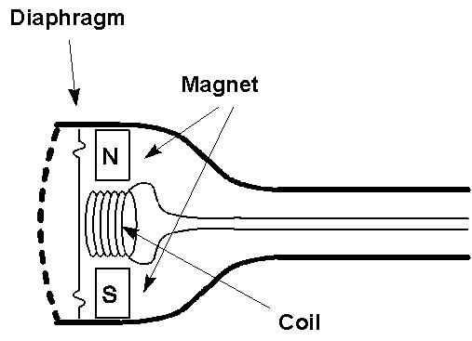
Applications of Magnetic Induction
AC Generator
  Water turns wheel
  → rotates magnet
  → changes flux
  → induces emf
  → drives current
“Dynamic” Microphones
  (E.g., some telephones)
  Sound
  → oscillating pressure waves
  → oscillating [diaphragm + coil]
  → oscillating magnetic flux
  → oscillating induced emf
  → oscillating current in wire
  Question: Do dynamic microphones need a battery?

Slide 21
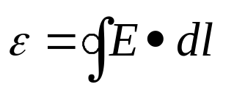
2. Induced emf 感生电动势
(Vortex electric field，涡旋电场)
time
A magnetic field, increasing in time, passes through the blue loop
An electric field is generated “ringing” the increasing magnetic field
Circulating E-field will drive currents, just like a voltage difference
Loop integral of E-field is the “emf”
Note: The loop does not have to be a wire—the emf exists even in vacuum! When we put a wire there, the electrons respond to the emf → current.

Slide 22
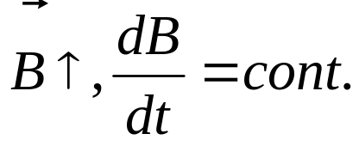
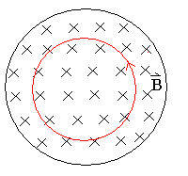
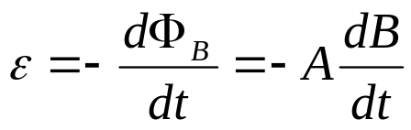
Induced emf (Cont.)
1. Induced electric field E
If there is a circular loop, induced current i, induced emf ε
If there is no circular loop,
induced emf ε
induced electric field E
Notes:
The induced electric field is just real as any that might be set up by static charges, for instance, it exists a force q₀E on a test charge.
The presence of the induced electric field has nothing to do with the presence of the loop of wire.

Slide 23





Induced electric field (感应电场)
The work W done on the charge by the induced electric field E in circular is q₀ε
Faraday’s Law:
For any point in space
It is apparent that Faraday’s Law implies that a changing magnetic field produces an electric field.

Slide 24




Notes
can be applied to any shape paths
E_{s} is set up by charges,
E_{in} is set up by changing magnetic field.
Both kinds of electric field exert on charges.
E_{s}:
E_{in}:
Note: In Ch. 28 we claimed , so we could define a potential independent of path. This holds only for charges at rest (electrostatics). Forces from changing magnetic fields are nonconservative, and no potential can be defined!

Slide 25


Application: The betatron
(电子感应加速器, 电子回旋加速器)
Betatron produces a pulsed (脉冲) rather than a continuous beam.

Slide 26



34-5. Induction & Relative Motion
In the Reference S fixed with B:

Slide 27

Induction & Relative Motion
W_{N}+ W_{i}=0, the work by force F_{L} on the charge carrier is zero. It does not apply energy, but play the role of transforming energy.
Motional emf is intimately connected with the sideways deflecting force by a magnetic field.

Slide 28




Induction & Relative Motion
The Reference S’ fixed with the loop:
Force is of purely electric origin,
In general in S’’:

Slide 29

Induction & Relative Motion
Electric and magnetic fields are not independent of each other. They are in one unity—electromagnetic field (电磁场).
The basic laws of electromagnetism, including Faraday’s law, hold in all inertial reference frames.
Maxwell’s equations are invariant with respect to the Lorentz transformation (电动力学).

Slide 30
Summary
Faraday’s Law (Lenz’s Law)
  a changing magnetic flux through a loop induces a current in that loop
negative sign indicates that the induced EMF opposes the change in flux
Faraday’s Law in terms of Electric Fields

Slide 31


Escher depiction of nonconservative emf

Slide 32
Homework
Page 793 (questions), 26, 33
Page 797(Problems), 6, 11,

